Slide 2
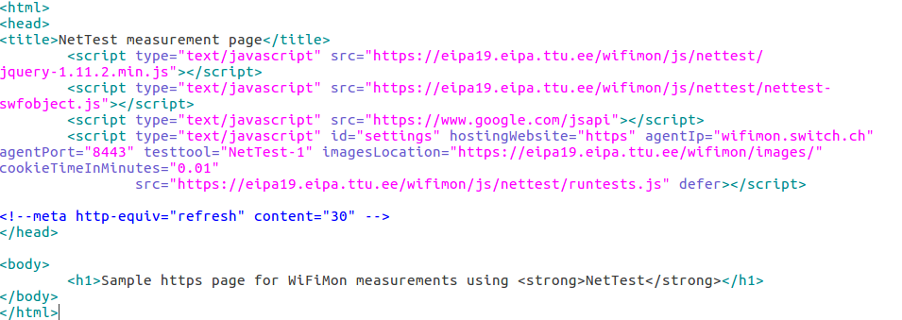
WiFiMon – Data Collection Technology
The end user visits a web page that includes JavaScript code. This triggers measurements.
Available Test Tools: Nettest, Boomerang, Speedtest
The process is collect, store, then (optionally) correlate
User Information

Slide 3
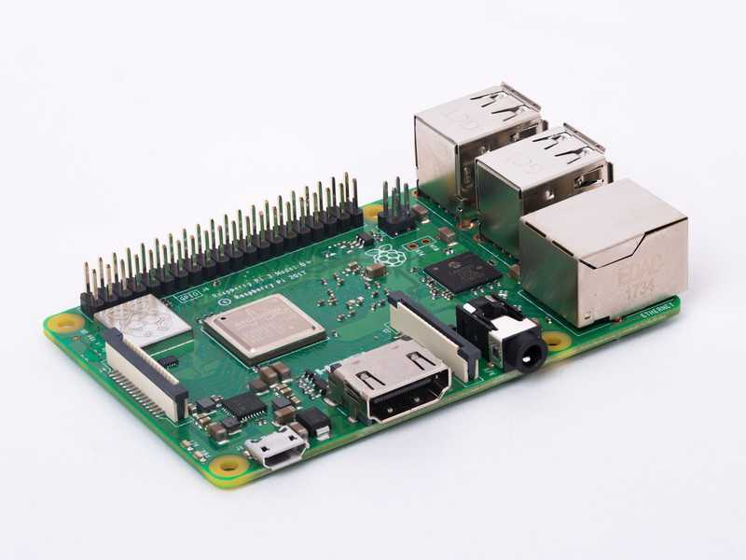
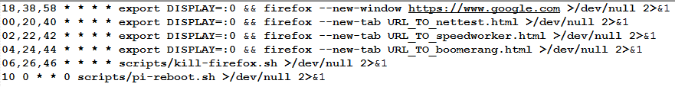
WiFiMon – Hardware Probes
Hardware Probes:
A Raspberry Pi 3 Model B+
A micro SD card with at least 16GB size
WiFiMon Raspberry Pi operating system image
(Size ~ 3.6 GB; available if you contact us for details)
A Simple 20-minute crontab:

Slide 4
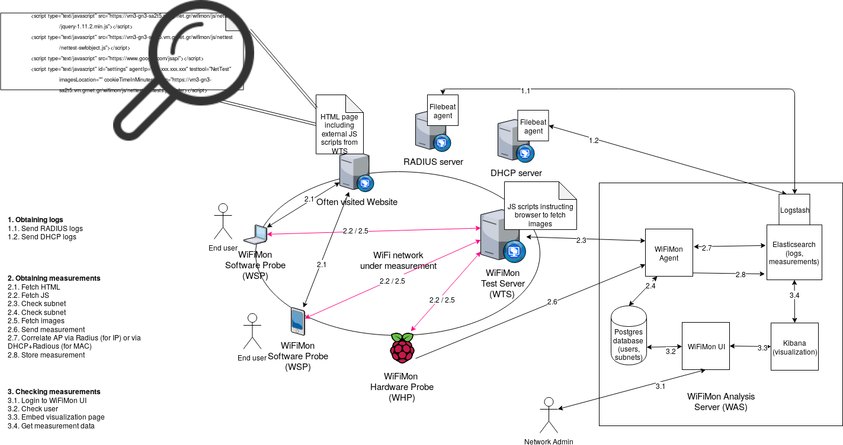
WiFiMon – Overall Architecture
WiFiMon Components:
- WiFiMon Software Probe (WSP) - WiFiMon Test Server (WTS)
- WiFiMon Hardware Probe (WHP) - WiFiMon Analysis Server (WAS)
4

Slide 5
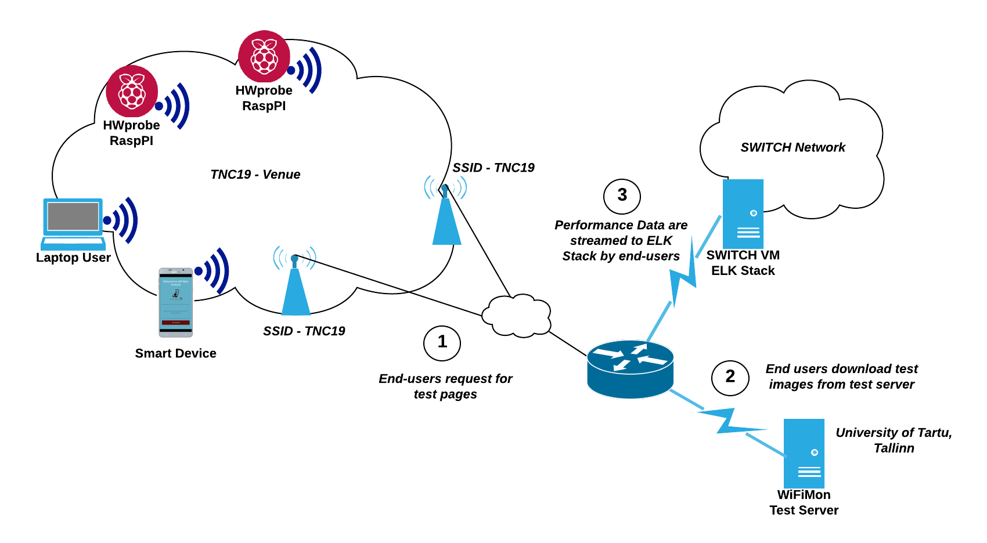
TNC19 Demo Testbed Overview

Slide 6
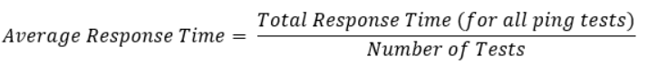
NetTest (https://code.google.com/archive/p/nettest/)
Measures Download Speed, Upload Speed and Ping Round Trip Time (HTTP Ping, not ICMP ping)
Download Speed: In WiFiMon, an image of 5 MB is downloaded. The file should be big enough to require several seconds to retrieve to give accurate results due to the TCP windowing behavior.
Upload Speed: A small file (image of 1 MB in WiFiMon) so that response data do not
affect the upload speed estimation. Calculated based on the same equation as above.
Ping RTT: Multiple tests are performed for a very small file (1.4 KB)
User Information
Not maintained since 2009

Slide 7
Speedtest (1) – Tests (https://github.com/librespeed/speedtest)
Types of files:
garbage.php: OpenSSL generates a stream of incompressible data
empty.php: Contains no data. It only sends the headers.
Download Test: Downloads the garbage data from server to client using XHR. Multiple parallel streams are used that are not synchronized. If a stream finishes the download, it is restarted. Every 200 msec, a timer updates the download speed and calculates a "bonus" time by which the test is shortened depending on how high the speed is.
Upload Test: As above, but using the empty.php file data.
Ping/Jitter test: This test works by creating a persistent HTTP connection to the server, and then repeatedly downloading an empty file, and measuring how long it takes between the request and the response. Calculations are based on the difference in timestamps. Jitter is the variance in ping times.
User Information

Slide 8
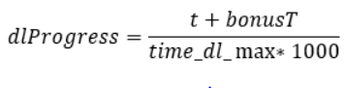
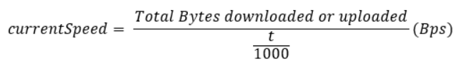
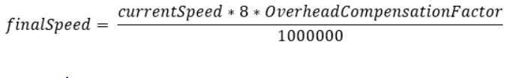
Speedtest (2) – Optimizations for Download/Upload Test
Bonus Time: It shortens the test duration. Tests become faster on faster connections and less data are wasted. The fraction of elapsed time for the test is:
where t is the elapsed time since the beginning of the test in msec, bonusT is the bonus time for the current test loop and time_dl_max is the maximum test duration.
Every 200 msec, the total Bytes downloaded/uploaded are used to recalculate the speed:
bonusT: It is calculated by:
Final Speed:
User Information
Compensation: Accounts for HTTP and network overhead, e.g. MTU, IPv6
In red: Empirical Values

Slide 9
Akamai Boomerang (https://github.com/akamai/boomerang)
Main Framework (boomerang.js) and plugins
BOOMR.plugins.RT: Measures page load time (RTT), or other timers associated with the page. The RT plugin can be combined with the BOOMR.plugins.NavigationTiming (RT handles results).
BOOMR.plugins.NavigationTiming: Collects performance metrics gathered by modern user agents that support the W3C NavigationTiming specification.
BOOMR.plugins.BW: Measures the bandwidth and latency of the user's network connection to your server.
BOOMR.plugings.BW Functionality: Apart from measuring bandwidth, it tries to include error value in the measurements
- Download 32 byte gif 10 times serially. First measurement is discarded because of TCP handshake. The other 9 are used to calculate arithmetic mean, standard deviation and 95% confidence interval of standard error. This returns latency.
- Download images whose size increases until one times out. Timeout is between 1.2 and 1.5 sec. We retry for the largest image 4 times. We then calculate the bandwidth for the largest 3 images that we downloaded. We gather a total of 7 measurements. From them, we calculate median, standard deviation and standard error
User Information

Slide 10
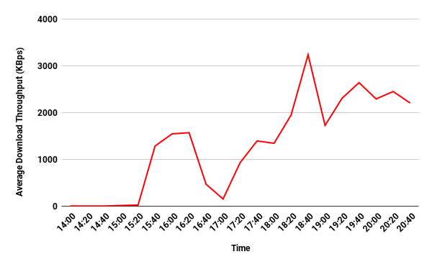
TNC19 Demo: Average Download Throughput in Main Room for H/W probes, Monday (14.00 - 21.00), Test tools average
WiFi problematic during the lightning talks plenary session (14.00 - 15.20)
WiFi OK in the afternoon when lots of people have left the main room
Worse throughput seen during the opening reception (17.00)
WiFi then OK in the evening

Slide 11
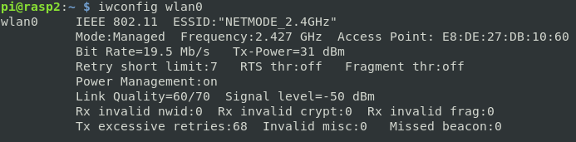
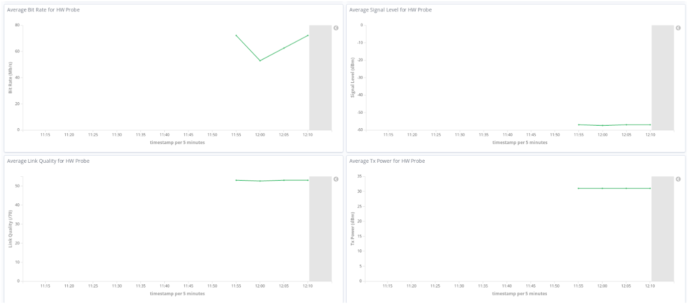
Integration of Additional Information from H/W Probes
Raspberry PI: A simple Python script parses the output of the “iwconfig” command and streams a JSON object to the WiFiMon Analysis Server (WAS) on intervals specified in a crontab
Collected Metrics
Kibana: New visualizations to display the collected metrics per H/W Probe:

Slide 12
GEANT Symposium Demo @ Ljubljana (2020) Correlation with Wireless Metrics from HW Probes
HW Probe | Signal Level | Bit Rate | Link Quality | TX Strength | Download Throughput (KBps) | Upload Throughput (KBps) | Ping Latency (msec)
1 | -55 | 65 | 60 | 31 | 1000 - 3000 | 500 – 1500 | 30
2 | -51 | 55 | 57 | 31 | 2000 – 3000 | 1000 – 2000 | 20
3 | -56 | 72 | 53 | 31 | 2000 – 3000 | 1000 – 2000 | 20
4 | -57 | 52 | 53 | 31 | 1000 – 2000 | 500 – 1500 | 30
5 | -65 | 78 | 44 | 31 | 2000 – 3000 | 1000 – 2000 | 25
6 | -63 | 65 | 47 | 31 | 1000 – 3000 | 500 – 1500 | 30
7 | -55 | 65 | 55 | 31 | 2000 -3000 | 1000 - 2000 | 30
Measurements from both HW Probes (7 of them) and end users in the Symposium
Throughput measurements do not necessarily follow the trends or Wlan metrics
- HW Probe 1 has the best link quality, but lower throughput - HW Probe 5 has lower link quality, but better throughputs
Deterministic and Crowdsources measurements are essential to reach conclusions about WiFi performance

